Slide 1
Optimizing AI Pipelines for Enhanced Image Segmentation and Object Detection
Mukul Palmia

Slide 2
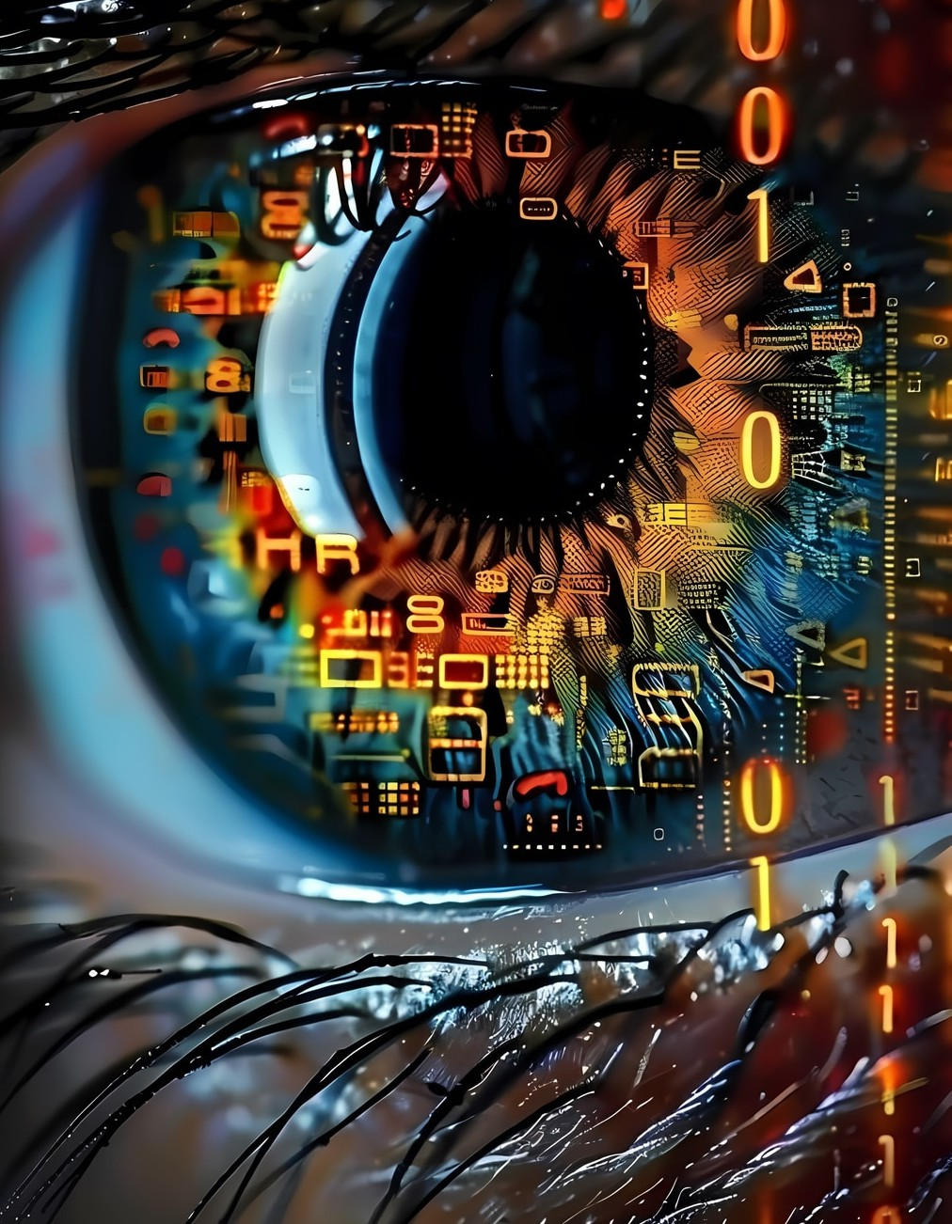




Introduction to AI Pipelines
In today's world,
role in enhancing tasks like
and
play a crucial
. This
presentation will explore techniques and strategies for optimizing these pipelines to achieve better performance and accuracy in various applications.

Slide 3




Understanding Image Segmentation
Image segmentation involves partitioning an image into multiple segments to simplify its representation.
is essential for improving
the accuracy of tasks, as it allows models to focus on relevant regions of interest in an image.

Slide 4





Key Techniques for Optimization
To enhance AI pipelines, consider techniques such as
, and
,
. These methods can signiﬁcantly improve the model's performance, leading to more accurate segmentation and detection results.

Slide 5


Challenges in Object Detection
Object detection poses unique challenges, including
and . Addressing these challenges requires the implementation of
robust algorithms and the use of diverse datasets to train models effectively.

Slide 6




Performance Metrics
Evaluating the performance of AI pipelines is crucial. Key metrics include ,
, and . Understanding these metrics helps in assessing the
effectiveness of the segmentation and detection processes, guiding further
optimizations.

Slide 7

Conclusion and Future Directions
Optimizing AI pipelines for image segmentation and object detection is an ongoing endeavor. By adopting best practices and staying updated with the latest advancements, we can ensure improved accuracy and efﬁciency in AI applications across various domains.
Mukul Palmia

